Slide 1
Generative Adversarial Networks
An Introduction to GANs
Korey MacVittie

Slide 2
Overview
GANs are a type of neural network architecture
Two competing networks, the “discriminator” and “generator”
Discriminators learn to assign correct labels to input
Two inputs, one “real” and one “generated”
Generators learn to produce output that fools the discriminator

Slide 3
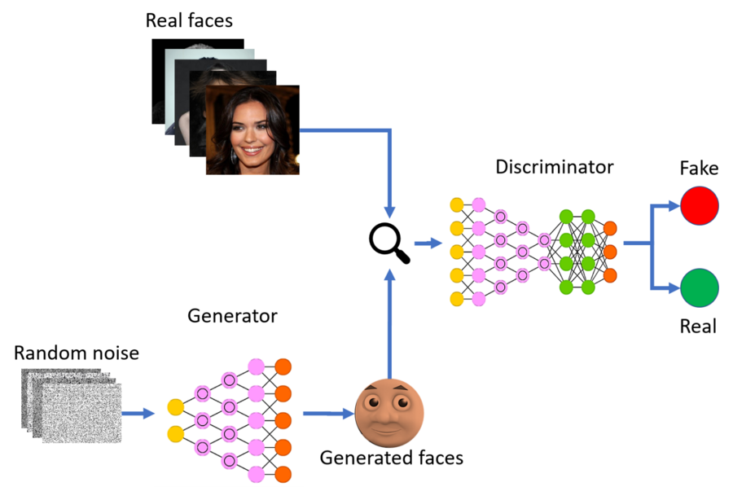

Slide 4
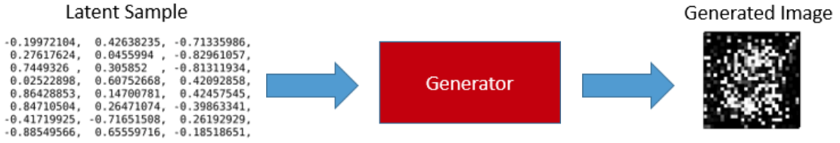
Generator
Generators typically begin by producing “garbage”
Uses back-propagation to improve generation
Relies on the discriminator

Slide 5
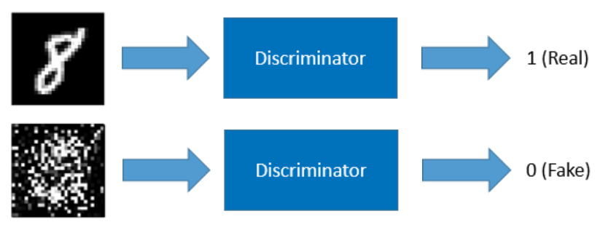
Discriminator
Requires labeled data
Training requires labeled and generated data

Slide 6
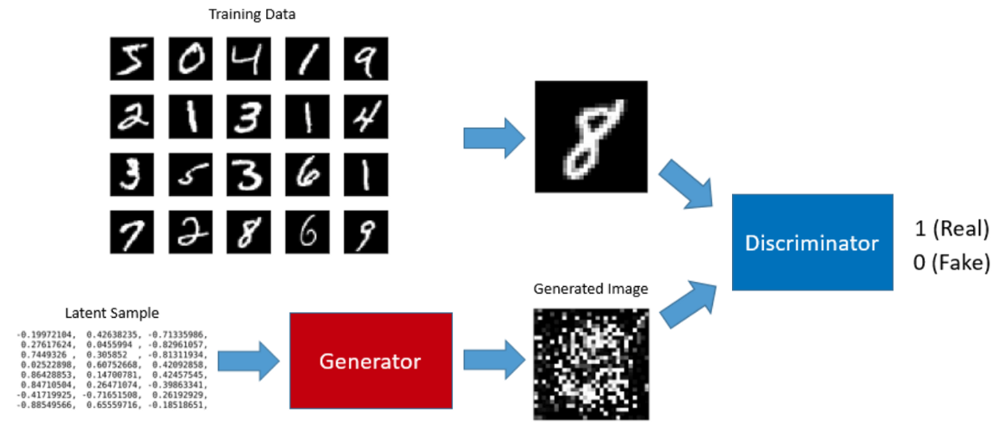
Gan Training Loop
Make the discriminator trainable
Train discriminator with both real and generated input

Slide 7
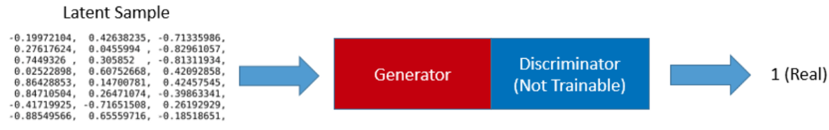
Gan Training Loop (Contd.)
Set the discriminator non-trainable
Train generator using “noise” and feedback
Relies on a trained discriminator

Slide 8
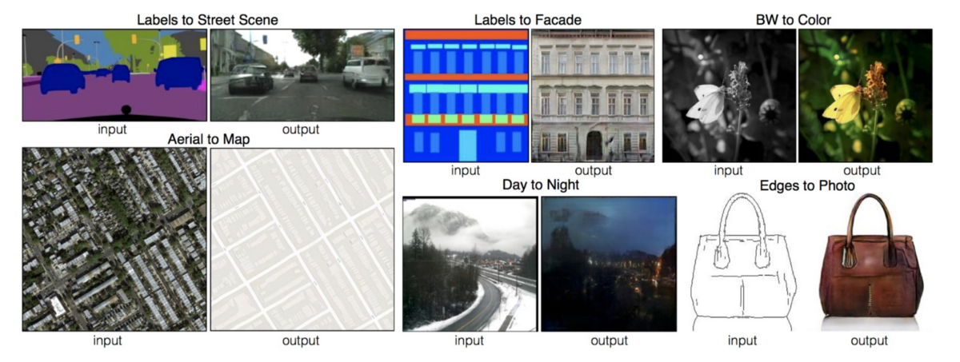
GAN Use Cases

